Slide 1


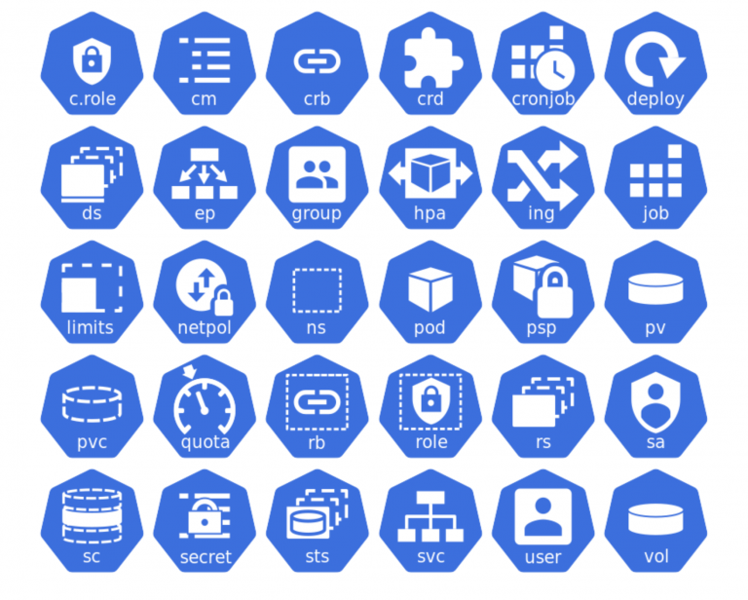
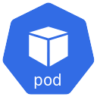
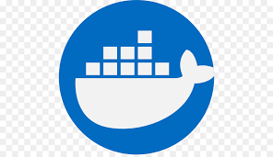

Kubernetes Architecture

Slide 2
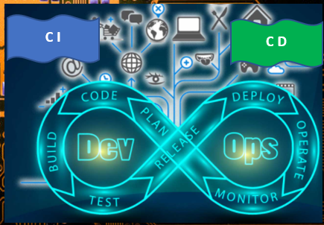
Computer Clusters
Kubernetes Cluster
Kubernetes is an open source Container orchestration platform for managing clusters of containerized applications and services. Developed by Google engineers Joe Beda, Brendan Burns, and Craig McLuckie in 2014 and open sourced shortly. Today managed by the Cloud Native Computing Foundation (CNCF), an arm of the Linux Foundation.
Kubernetes now has more than 2,300 contributors, and has been widely adopted by companies large and small, including half of the Fortune 100.
Some Key Terms – Cheat Sheet
Kubecon
Cluster
Is a set of computers individually referred to as nodes used to run containerized applications managed by Kubernetes.
Node
Is either a virtual or physical machine. A cluster consists of one or more shared control planes (master node) and a number of worker nodes.
Cloud Container
Is an image that contains software and its dependencies.
Pod
Is the Smallest building block in the k8 cluster also it is a single container or a set of containers running on your Kubernetes cluster.
Deployment
Is an object that manages replicated applications represented by pods. Pods are deployed onto the nodes of a cluster.
Replicaset
Ensures that a specified number of pod replicas are running at one time.
Service
Describes how to access applications represented by a set of pods with in the cluster. Services typically describe ports and load balancers, and can be used to control internal and external access to a cluster.

Slide 3
Kubernetes Architecture
Cluster Configuration – t2.medium , 4gb , 2 CPU
sudo kubeadm join 172.31.23.26:6443 --token h91ctg.34qsjrc9vb8hq1z0 \
--discovery-token-ca-cert-hash sha256:0be50bcd5eb36b4b75252fce491357afb870707f41598d003f1db0c52475c54a
Common to all nodes
sudo apt -y install vim git curl wget kubelet kubeadm kubectl
sudo tee /etc/sysctl.d/kubernetes.conf<<EOF
net.bridge.bridge-nf-call-ip6tables = 1
net.bridge.bridge-nf-call-iptables = 1
net.ipv4.ip_forward = 1
EOF
Install Docker
sudo kubeadm init --pod-network-cidr=10.244.0.0/16
mkdir -p $HOME/.kube
sudo cp -i /etc/kubernetes/admin.conf $HOME/.kube/config
sudo chown $(id -u):$(id -g) $HOME/.kube/config
sudo kubectl apply -f https://raw.githubusercontent.com/coreos/flannel/master/Documentation/kube-flannel.yml
WK - NODE 1: 192.168.49.2
Sudo ubeadm join 172.31.23.26:6443 --token h91ctg.34qsjrc9vb8hq1z0 \
--discovery-token-ca-cert-hash sha256:0be50bcd5eb36b4b75252fce491357afb870707f41598d003f1db0c52475c54a
Master- NODE 1: 192.168.49.5
Control Plane
WK - NODE 2 : 192.168.49.3
ubuntu@ip-172-31-23-26:~$ kubectl get nodes
NAME STATUS ROLES AGE VERSION
master Ready master 35m v1.15.7
node1 Ready none> 15m v1.15.7
node2 NotReady <none> 9s v1.15.7

Slide 4
Kubernetes Architecture
Make sure the containers are running in a pod
Cluster components
Kubelet
Manages the services
Kube-proxy
Act as the front end
Responsible for running containers
Kube -API - Server
Container runtime
Assigns workloads to nodes
Links the cluster to cloud provider API
Kube Schedular
WK - NODE 1: 192.168.49.2
Cloud Controller Manager
Kube Controller Manager
Kubelet
Key Value store for all cluster related data
Kube-proxy
etcd
Master- NODE 1: 192.168.49.5
Control Plane
Container runtime
Node Controller
Job Controller
Endpoints Controller
SA & TKN Controller
WK - NODE 2 : 192.168.49.3

Slide 5
Kubernetes Architecture
Components Workflow
KUBECTL
~/.kube and ~/.minikube
Kubelet
Kube -API - Server
etcd
Container runtime
Cloud Controller Manager
Kube Controller Manager
Kube-proxy
WK - NODE 1: 192.168.49.2
Validated and authorized request by API- Server
My App
SVC
Namespace
Kube Schedular
Kubelet
SVC
Kube-proxy
Master- NODE 1: 192.168.49.5
Control Plane
Container runtime
WK - NODE 2 : 192.168.49.3

Slide 6
To be the ultimate knowledge hub for the most demanding technologies in the industry.
Technology Innovation Hub
tnhwithlaksiri@gmail.com
Thank You.

